Slide 1
Washington State:
FHIR Forward
Dr. Bryant T. Karras
Chief Medical Informatics Officer
Washington State Department of Health
March 6, 2025

Slide 2

Welcome
Dr. Bryant T. Karras MD FACMI
Chief Medical Informatics Officer, WA State Dept. of Health and University of Washington
Biomedical Engineer
Internal Medicine Physician
Epidemiologist
Public Health Informatician
As CMIO, Bryant guides informatics agency-wide including innovative technologies such as SMART Health Cards. Bryant is passionate about improving public health’s use of health information technology.
2024 Change Maker and 2023 Davies Award winner

Slide 3

Our Vision
Washington State Dept. of Health
Advance
Advance inter and intra-organizational interoperability with reusable building blocks
Un-Silo
Break down data silos and create data linkages between different programs in DOH
Standardize
Standardize public health data with a common data model for exchange internally and externally with the use of HL7 FHIR, on a need basis where it demonstrates business value
Compliance
Meet federal, state, and local HL7 FHIR requirements and contribute, as a leader, to public health FHIR initiatives

Slide 4
Infrastructure: Major Components
Data consumption endpoints
Data exposure endpoints
System for processing data and storage/shipping to respective data owner systems
Data transformation pipelines
User Interface development tools

Slide 5

FHIR Roadmap
Step 1: Development of Common data collection capabilities
Utilizes the common data model in FHIR
Uses FHIR service, Rhapsody interface engine and data processing pipelines
Step 2: Development of Data Processing Pipelines
Data transformations needed
Data assets curation and provisioning (in collaboration with Data Science team)

Slide 6
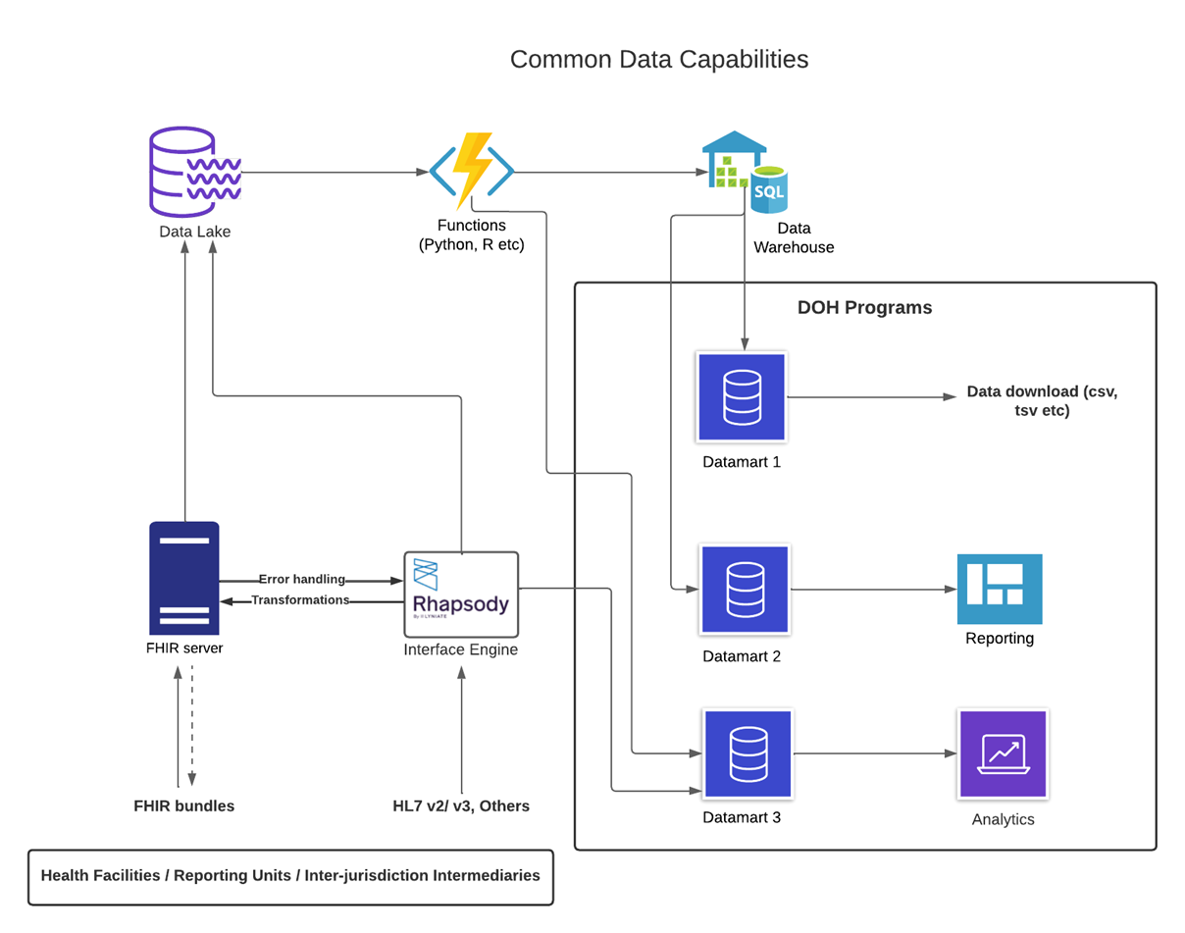
FHIR Roadmap: High Level
Notes:
This slides depicts how DOH plans to process the data and package/provision them in different forms for the respective program teams to use based on their need
This is a generalization of the service that will be provided to the program teams.

Slide 7






Washington State Department of Health’s FHIR Ecosystem
SMART on FHIR app for PDMP: COSRI - Clinical Opioid Summary with Rx Integration
Installed in providers EMR or stand alone
WA Health Summary with SMART Health Links
Portable International Patient Summary (IPS)
WA Health: Hospital Capacity – SANER / SAFR – Situational Awareness
Helios innovation and standards development
Death data - Vital Records Death Reporting
PHFIC State and Local partnership with NCHS in adoption of FHIR
Co-Propel Birth Records & Newborn Screening (NBS)
Communicable Disease Surveillance (eCR)
Chronic Disease Population Level Monitoring (TRAX)
Immunization Information System Bulk Data Exchange

Slide 9
WA Health
Washington’s Healthcare Emergency And Logistics Tracking Hub
Provides state-wide view of:
Hospital capacity for acute care, ICU, and surge beds
Ventilator availability
Supplies & PPE
Influenza & RSV Statistics
The Situational Awareness Platform for DOH
Future capabilities: Behavioral Health, Automated Reporting (FHIR), Near real-time bed capacity, BH bed registry
Other conditions/emergency situations' victims tracking (wildfire, flood, hurricane, tornadoes etc.)​
Notes:
WA HEALTH’s mission is to operate and enhance a technology platform that collects key health care data to help leaders make timely and informed decisions in response to public health threats.
NEED: SANR and SAFER from Ravi

Slide 10

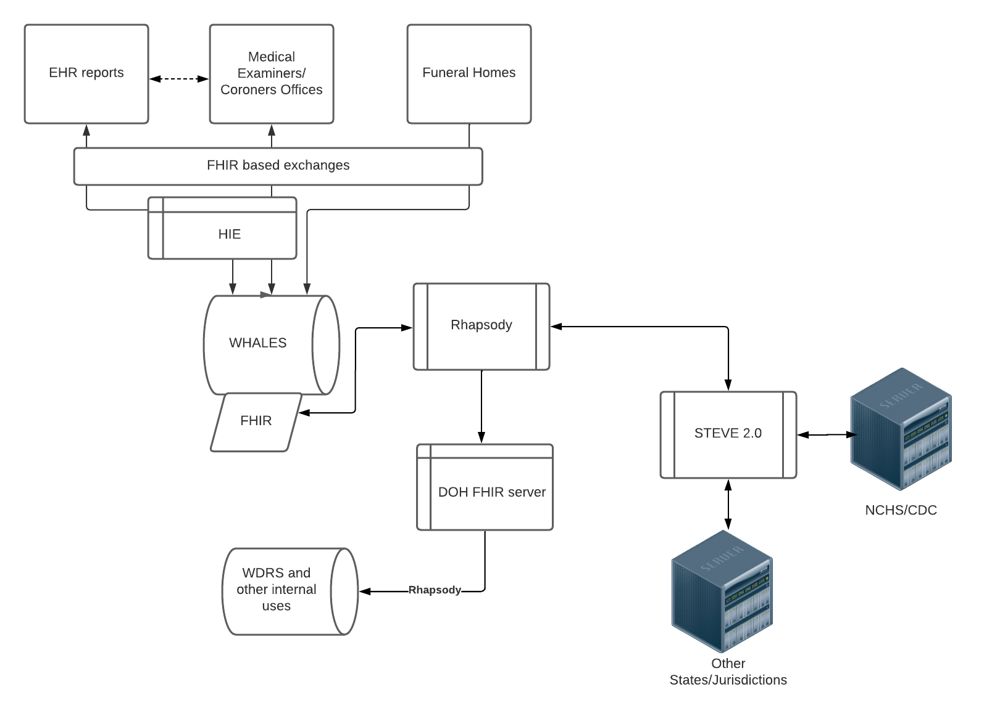
Vital Records Death Reporting
Three Phase FHIR Pilot
Phase 1: Sending death record data from DOH to Public Health Seattle King County (PHSKC)
Phase 2: Death investigation data from PHSKC to DOH
Phase 3: Bulk immunization lookup
Notes:
Exchange of data standardized with HL7 FHIR and exposed with REST APIs has great potential for breaking data silos:
Between different programs in DOH
Between the State and the LHJs
Between public health and health care systems
Death data interoperability with disease registries could be a 'plug and play' between systems rather than putting manual efforts for data merging and performing analytics e.g. Condition specific death rates

Slide 11

1
Improved Data Sharing
TEFCA can enable seamless data exchange between healthcare systems, allowing real-time reporting of respiratory illness cases.
2
Reduced Administrative Burdens
By automating data sharing, TEFCA reduces the administrative workload on healthcare providers who otherwise must manually report case details.
3
Timely Public Health Decision Making
With faster and more comprehensive data access, public health authorities in Washington State can make more informed decisions, respond quickly to potential outbreaks, and allocate resources more effectively.
Notes:
The Trusted Exchange Framework and Common Agreement (TEFCA) is a federal initiative designed to facilitate secure, interoperable exchange of electronic health information across healthcare organizations nationwide. By connecting different QHINs, TEFCA ensures that critical patient data can be shared seamlessly, regardless of the systems used by individual providers.
By utilizing TEFCA, the Washington State Department of Health can make notable improvements to the RESP-NET surveillance system processes and data.

Slide 12
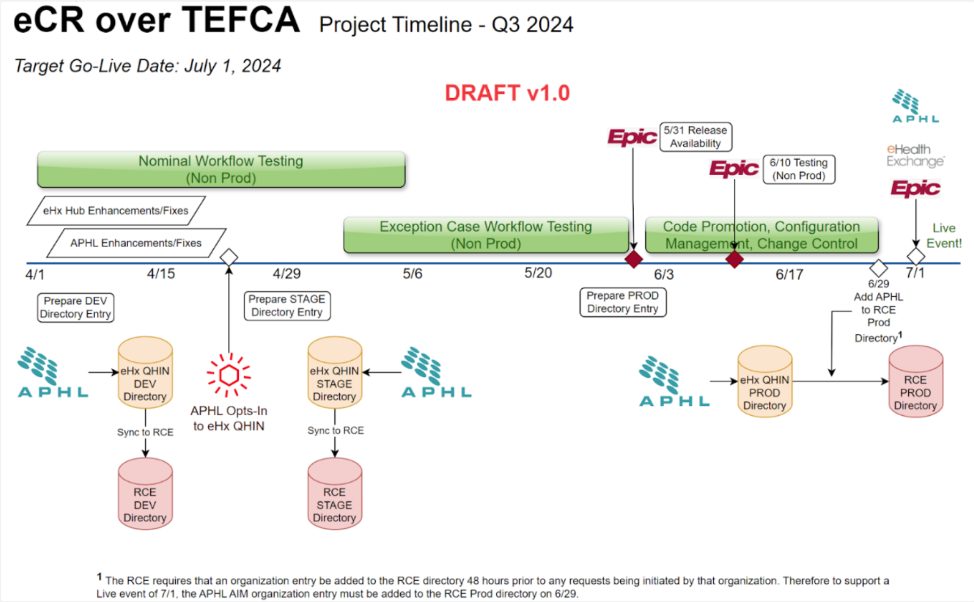

Slide 13
CURRENTLY: Process to get laboratory and healthcare patient data from healthcare facilities to LHJs and then to Washington Disease Reporting System is manual and time intensive.
GOAL: Reduce the manual load on healthcare facilities, LHJs, and WA DOH while increasing efficiency and analytic capabilities.
WA DOH and King County are piloting an automated system for querying Qualified Health Information Networks (QHINs) under the Trusted Exchange Framework and Cooperative Agreement (TEFCA) using Skylight’s Query Connector.
Notes:
The Respiratory Virus Hospitalization Surveil-lance Network (RESP-NET) is a CDC-sponsored network of 13 U.S. states that monitors laboratory-confirmed hospitalizations associated with:
• Influenza
• Respiratory Syncytial Virus (RSV)
• COVID-19
RESP-NET sites gather data from laboratory and healthcare facilities to understand trends in virus circulation, estimate disease burden, and respond to outbreaks. The data collected by RESP-NET sites allow disease severity comparisons across seasons, states, and demographic groups.
In WA state data about laboratory-confirmed hospitalizations associated with influenza, RSV, and COVID-19 come from:
• Statewide syndromic surveillance of hospital admissions due to respiratory viruses
• Electronic Laboratory Reports of laboratory-confirmed cases
• Healthcare facility lists of hospitalized patients
• LHJ investigation of cases

Slide 14

GOAL: Develop a “minimum loveable product” (MLP) for TRAX data exchange and analytics.
Three Phases:
Phase 1: Build on Multicare’s current FHIR Infrasture (eCR Now FHIR App)
Automate data extracts – Diabetes, Hypertention
Phase 2 : Leverage existing PH data visualization and querying tools to produce analytic products
MENDS ESP Software
Phase 3 : Engage additional healthcare provider organizations to submit data
Use Master Person Index for de-duplication
Notes:
The WA Healthcare Forum Board and WA Department of Health (DOH) leadership asked staff to convene a work group to improve chronic disease surveillance in Washington state
Work group = Forum member reps, DOH, and OneHealthPort (state HIE)
-Met monthly during 2023/2024 with focus on…
Providing health care and public health professionals with more timely, actionable chronic disease surveillance information
Potential for a shared system with shared data & governance
Recognition that better chronic disease surveillance would be useful for our state.
People with chronic conditions – often multiple chronic conditions – are your most complex patients.
Chronic conditions like hypertension and diabetes are among most common conditions we deal with in the US healthcare system

Slide 15







Data Partners
Data Pipelines / Data Use Agreements
MultiCare Connected Care
Data submitter
Association of Public Health Labs
eCR Now FHIR App
eHealth Exchange
Verbal agreement
Already has connections to MC and CRISP
Minimum Loveable Product Partners
Master Data Management
Data Analytics
CRISP Shared Services / State HIE
Very interested/exploring
.
CRISP Shared Services / State HIE
Very interested/exploring

Slide 16
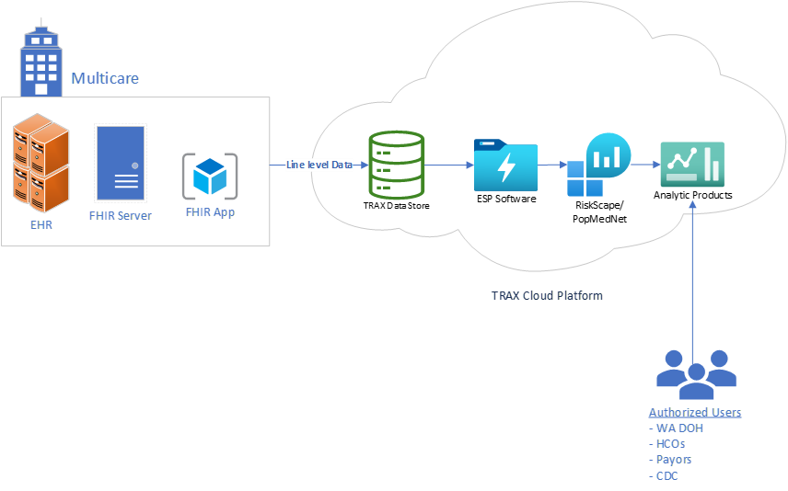




Phase II

Slide 17



Birth Records & Newborn Screening (NBS)
Three major activities:
Short-team follow up data to get clinical diagnostic data to NBS program for case close-out
Defining business case
Finalizing data use agreement
Investigating Query Connector Tool, Direct Connect to hospitals vs. eHealth Exchange
Long-term follow-up(LTFU) data
Action steps: Will build on activities of LTFU Work Group and lessons from short-term follow-up interoperability work
Birth Notification – ensure every baby has received a screen
Action Steps: Define business case and identify needs

Slide 18
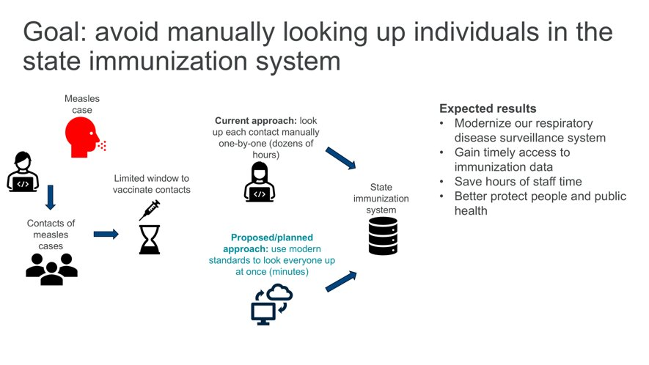
Immunization Information Systems Bulk Data Exchange

Slide 19

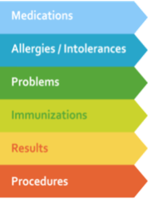


WA - Health Summary (WA Verify+)
Utilizing the International Patient Summary (IPS)Standard
Patient directed key verifiable clinical data for travel
Embedded URL in a QR code that links to data and/or FHIR endpoints
Patient Summary Demo Link

Slide 20
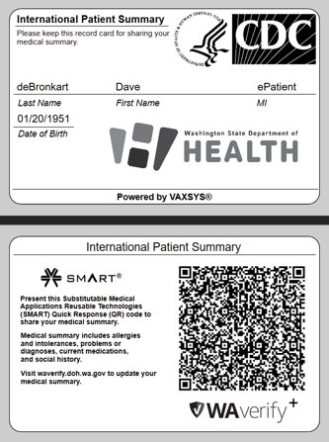



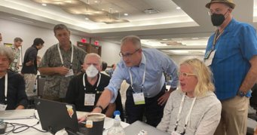
Empowering Patients with their Data
Notes:
In 2008, Casey Quinlan was diagnosed with breast cancer ​
“Some doctors have misunderstood their place in the doctor-patient relationship. We’re partners in our care. People – again - the ones called “patients” in this party, are not worshipers at the altar of medical professional knowledge, nor are we lesser beings because we don’t have MD behind our names…you’re the partner in your own care” ​
“Why did I do this? Because I’ve been waiting for the medical-industrial complex to deliver on their promise of health information exchange (HIE), the promise that they’ve been making for years, but have yet to fork over” (2015 QR Code Tattoo)​
She passed in hospice on April 25, 2023​

Slide 21
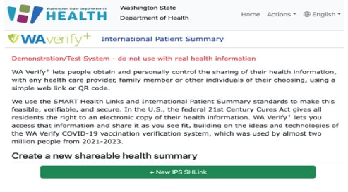
Multiple Methods for Access and Storing
SMART Authorization​
Epic​
Oracle/Cerner​
MEDITECH​
FHIR URL​
FHIR Bundle​
TEFCA Query

Slide 22


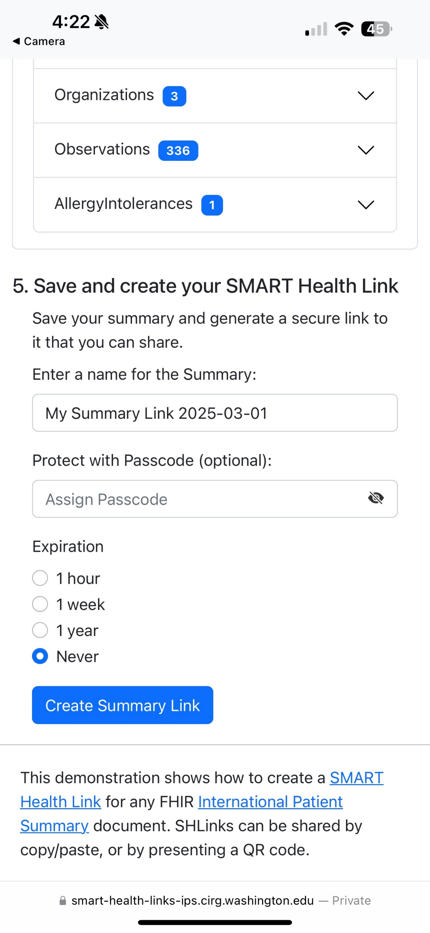
Mobile Health Summary
1
Patient Controlled
Each method of access provides a selection for expiration duration – 1 hour, 1 week, 1 year, Never​
2
Verifiable & Secure
SMART Health Link can be passcode protected for additional security.
3
Manage Dependent Records
Health data from dependents/children accessible under the same Link/QR Code

Slide 23
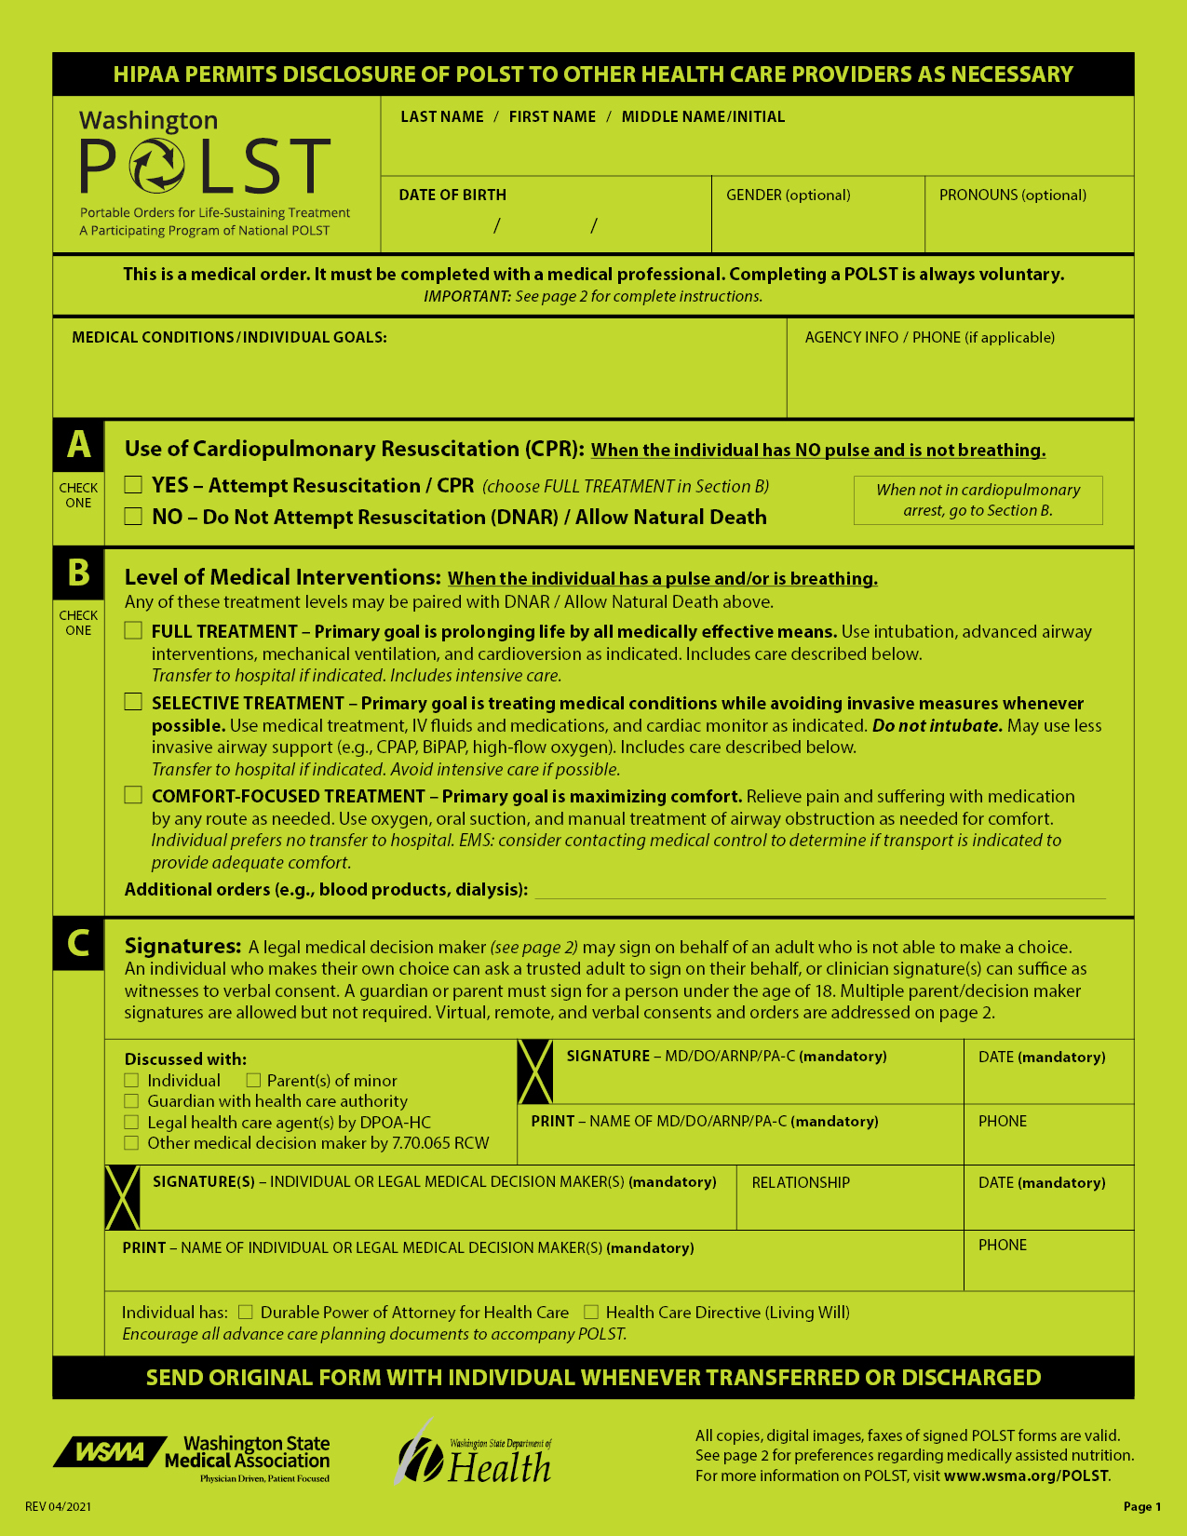

Portable Orders for Life Sustaining Treatments
Moving from paper forms to digital portable wishes
POLST
Advanced Directives
MHAD
Power of Attorney
Participating in HL7 standards development
Currently in WA legislative process
HB 1724
Notes:
Add paper form image
Budget Proviso to explore creation of a registry for these forms
Environmental Scan (Partner: UW SoPH)
Peer Review Literature (32 articles)
Official Reports (from other states)
Met with 7 states to learn
Request for Information (Registry)
Hope to release this month
Recommendations to Improve Proposed Legislation
Digital Submission Only
Mandatory Provider Submission
Broaden registry to cover all types of advanced directives
POC for reuse of WA-Verify for Portable Medical Orders (Partner: UW CIRG)
Connect-a-thon Testing
Work with PACIO HL7 WG

Slide 24




















Public-Private-Academic Partnerships
Notes:
Multicare, Epic, CRISP, Meditech

Slide 25



















































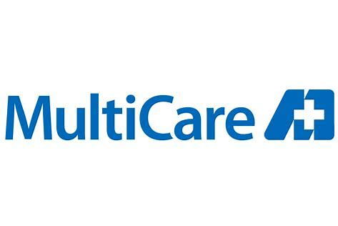

Importance of Strategic Partnerships

Slide 26
Questions
Use this slide for Q&A at the end of your presentation
Remind attendees to complete an online evaluation for your session

Slide 27


Thank You
Contact Information:
Bryant Thomas Karras, MD FACMI
Chief Medical Informatics Officer
www.doh.wa.gov/healthit
Bryant.Karras@doh.wa.gov
BKarras@UW.edu

